Slide 1
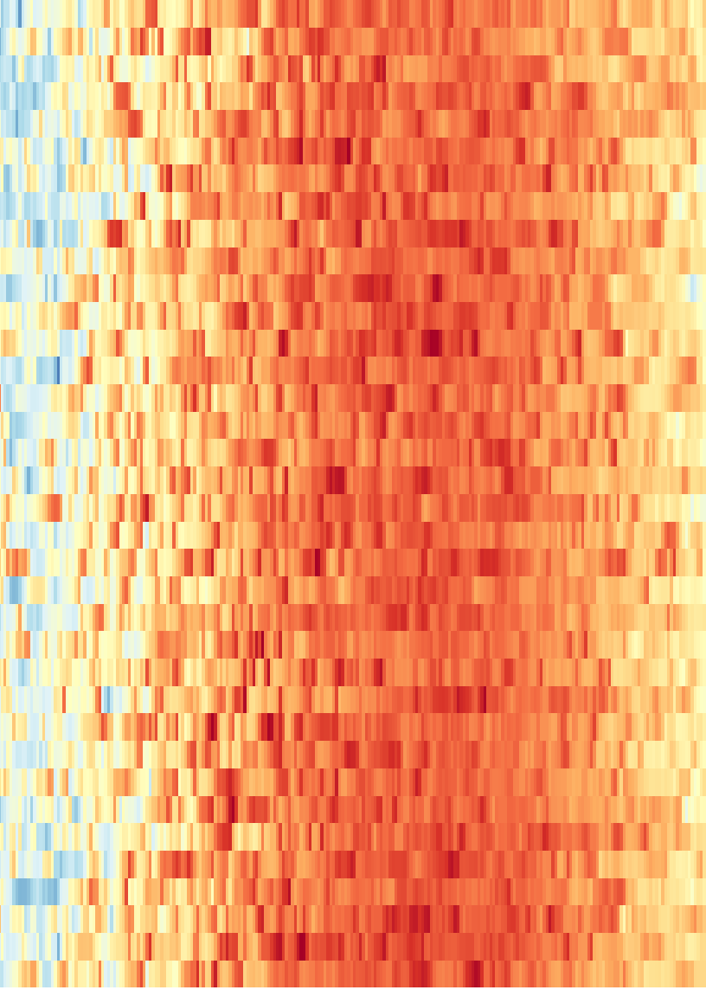
From exploring the past to forecasting tomorrow
CAIRO · 1990–2025 · TASK 4 → TASK 5
36 years of daily NASA data: what Task 4 found, what Task 5 forecast, and what each one taught me.
TASK 4 · EXPLORE
TASK 5 · FORECAST
Patterns, six questions and the numbers to beat
Tomorrow’s temperature, tested on unseen years
Esraa · Cairo weather prediction · Right: every day since 1990, by max temperature →
Notes:
This deck follows one project in two stages. Task 4 cleaned 36 years of Cairo weather, explored it, asked six questions and set the numbers to beat. Task 5 used those findings to forecast tomorrow’s mean temperature, and tested every Task 4 answer on years the model never saw. Headline: 0.94 °C typical error on 2023–2025, about 10 % better than simply repeating today.

Slide 2
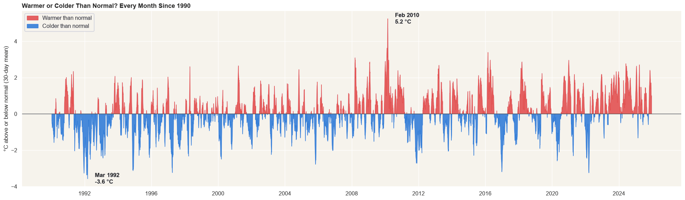
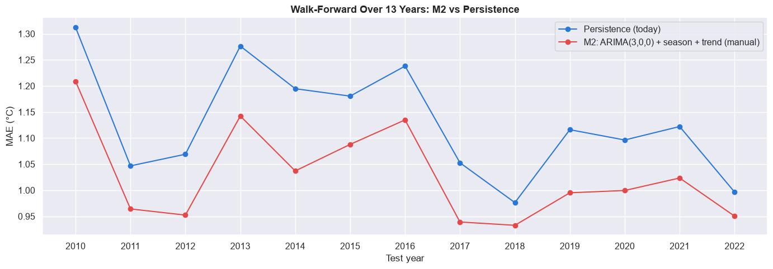

Same data, a sharper question: tomorrow
THE BIG PICTURE · TASK 4 VS TASK 5
TASK 4 · UNDERSTAND THE PAST
TASK 5 · FORECAST TOMORROW
Fig. 6b · Warmer or colder than normal, 1990–2025
Fig. 22 · M2 vs “tomorrow = today”, 13 unseen years
1.04 °C
the number to beat: “tomorrow = today” on 2023–2025
0.940 °C
M2 on 2023–2025: 9.5 % below the bar
Describe 36 years and answer six questions from the same years
Predict from today only, and check every answer on the future
SO WHAT
Task 4 asked what happened; Task 5 asks what can be known before it happens.
Cairo weather forecasting · Esraa
Source: NASA POWER, 1990–2025 · 02 / 31
Notes:
Both tasks use the same clean daily data and the same split by years. The difference is the question. Task 4 described the past and set the bar: repeating today gives a 1.04 °C error. Task 5 built a model that beats that bar on unseen years, in every one of 13 walk-forward years, and re-tested every Task 4 answer.

Slide 3
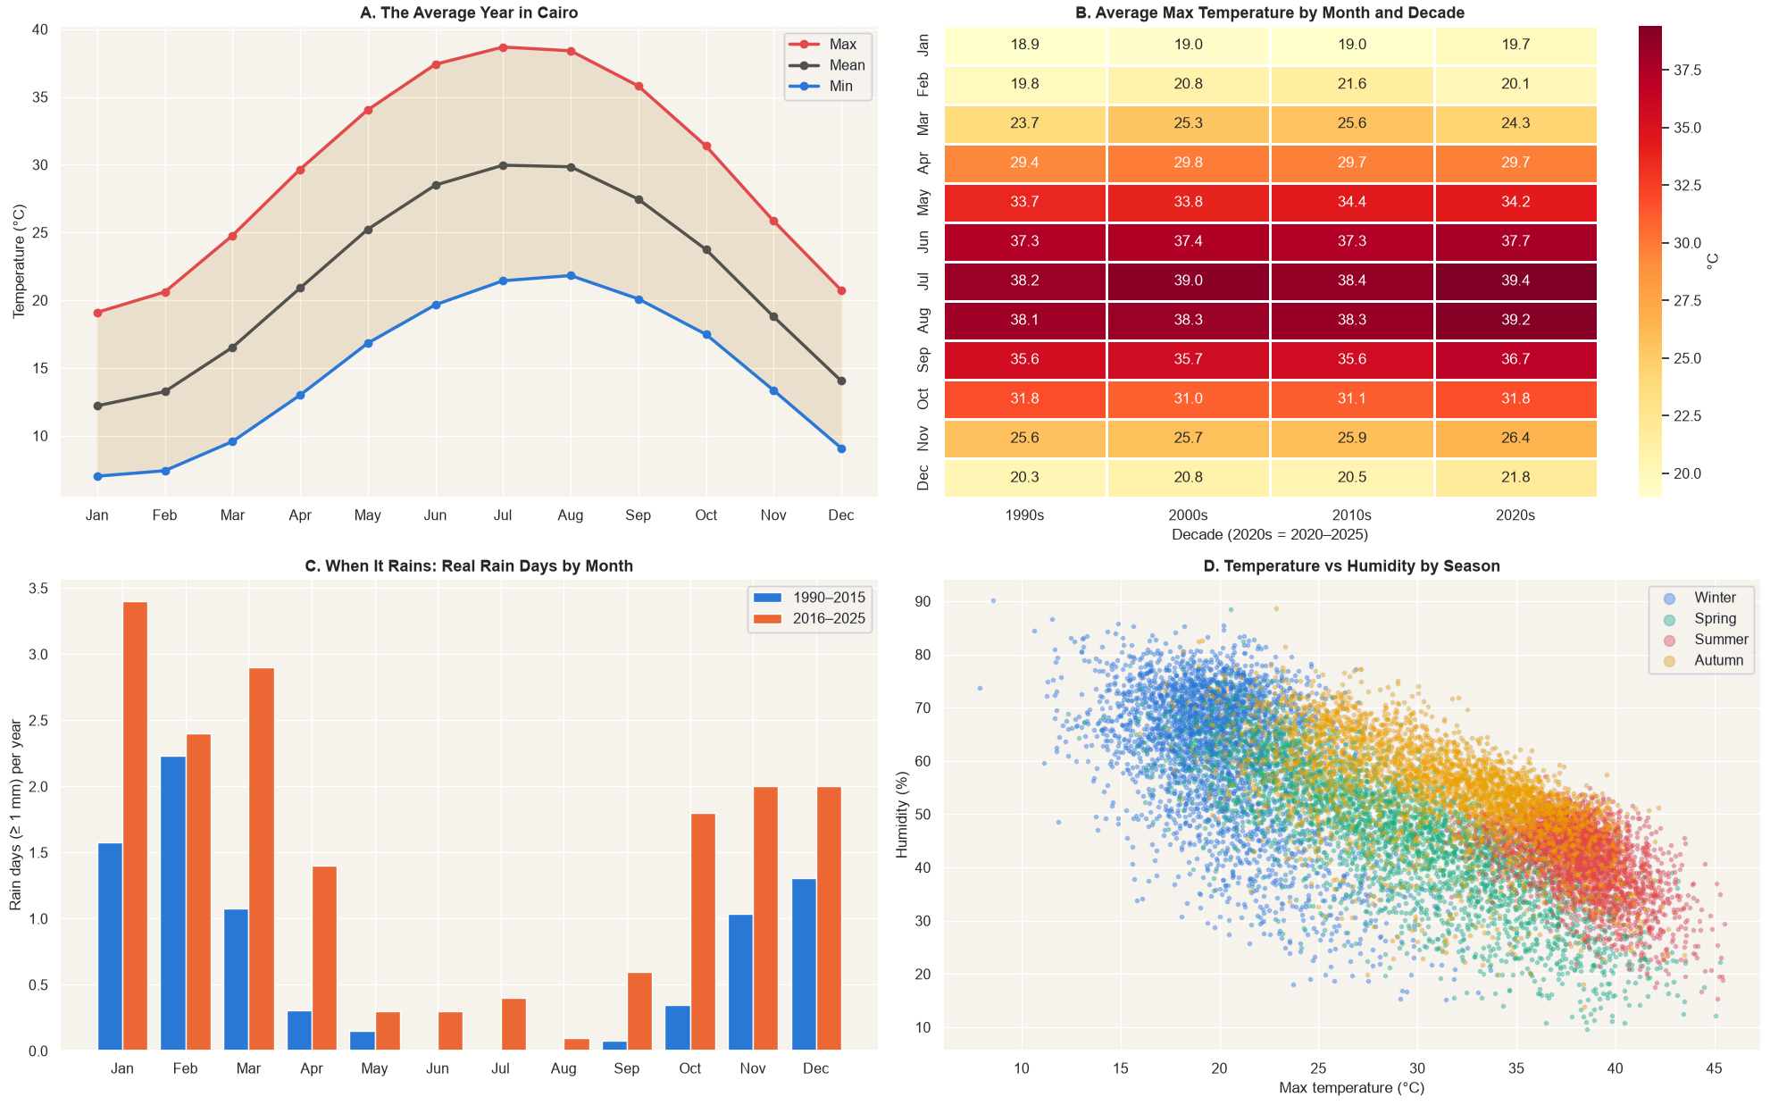
The season rules, and memory is short
TASK 4 RECAP · INSIGHTS
Fig. 5 · Cairo climate overview, 1990–2025 (Task 4)
~19 °C
0.97
season swing, January to July–August
link today → tomorrow; 0.77 without season
~5 days
39 vs 5 %
of memory; ~0 link after a year
chance of rain tomorrow after a rain day vs normally
SO WHAT
The calendar and yesterday carry most of the signal. A model’s real job is the ~2.2 °C of daily weather left over.
Cairo weather forecasting · Esraa
Source: NASA POWER, 1990–2025 · 03 / 31
Notes:
Task 4’s main insights. The year repeats the same way: a 19 °C swing, with the 2020s having the hottest summers and rain falling from October to April. Today and tomorrow are linked at 0.97; even with the season removed it is 0.77, and the link fades within about five days and is gone after a year. Rain comes in groups: 39 % chance after a rain day against 5 % normally. Every Task 5 input comes from these numbers.

Slide 4
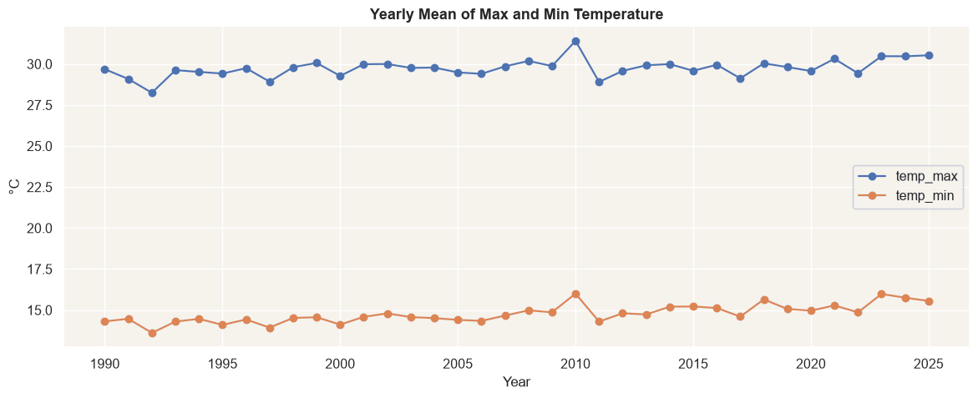
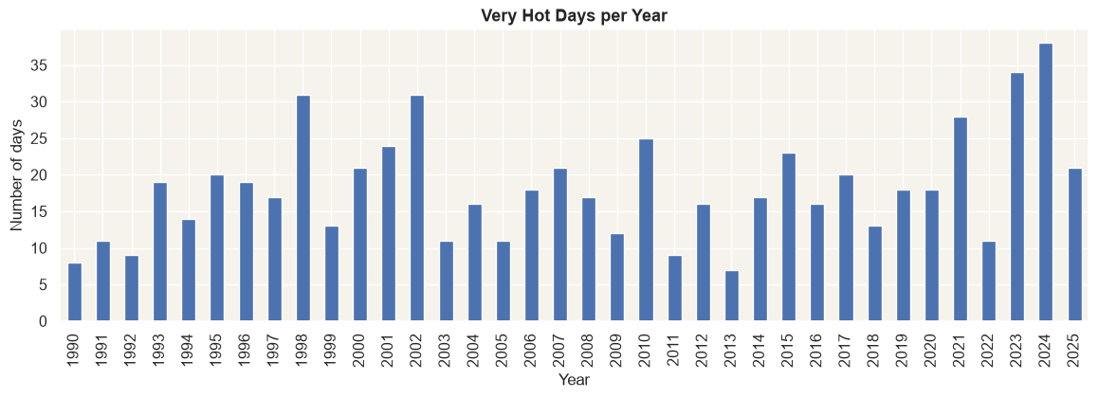
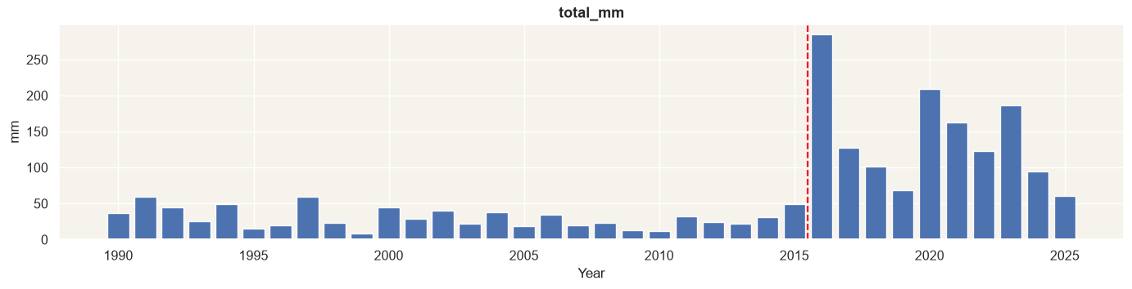
Warming, more hot days, and a data trap
TASK 4 RECAP · RESULTS
+0.41 °C
7 → 38 days
8.1 → 17.6
per 10 years for nights; days +0.23 °C
very hot days (max > 40.1 °C), 2013 vs 2024
rain days a year, before vs after 2016
Fig. 6a · Yearly mean of max and min
Fig. 7a · Very hot days per year
Fig. 8a · Total rain per year: a jump at 2016
H1: Yes. The test years are the warmest: watch for a cold bias.
H2: Partly. H4: Yes, slowly (−1.9 very cold nights per 10 years).
H3: a data change, not weather. Rain work uses 2016–2025 only.
Cairo weather forecasting · Esraa
Source: NASA POWER, 1990–2025 · 04 / 31
Notes:
Three Task 4 results that shaped Task 5. Cairo is warming, nights faster than days, and the test years 2023–2025 are the warmest, so a model trained on earlier years may run cold. Very hot days jumped from 7 in 2013 to 38 in 2024, but one or two extreme years are not yet a trend. And the rain record doubles at one single year, 2016, while storm strength stays flat: most likely a change in the data, so all rain work uses 2016–2025 only.

Slide 5
The numbers every model must beat
TASK 4 RECAP · BASELINES
Fig. 14 · Temperature tomorrow: MAE of simple baselines (°C, lower is better)
1.04 °C
Persistence (today)
1.07 · 1.04
temperature bar: “tomorrow = today” on test
Mean of last 7 days
1.59 · 1.54
F1 0.47
Climatology (date normal)
1.84 · 1.79
rain bar: “rain today → rain tomorrow”
Same day last year
2.56 · 2.27
Validation 2020–22
Test 2023–25 (trained on 1990–2019)
SO WHAT
Weather changes slowly, so today is the best guess. A Task 5 model is useful only if it beats these on the same days.
RAIN TOMORROW (2016–2025)
“Always no rain”: 94–96 % accurate, yet 0 rain days caught, so accuracy is not used.
Persistence (rain today): F1 0.36 validation, 0.47 test.
Cairo weather forecasting · Esraa
Source: NASA POWER, 1990–2025 · 05 / 31
Notes:
Task 4 ended with simple forecasts that need no learning. For temperature, repeating today wins clearly: 1.07 °C on validation and 1.04 °C on test. Last year’s same day is mostly luck. For rain, “always no rain” reaches 96 % accuracy while catching zero rain days, which is why rain is judged by hits, misses and F1. These two numbers are the bars Task 5 has to clear.

Slide 6
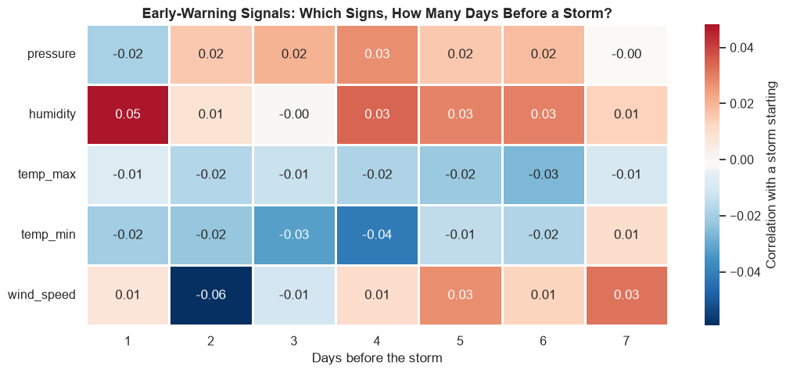
Six questions, answered from the past
TASK 4 RECAP · RESEARCH QUESTIONS
H1
H2
H3
Fig. 12a · H5: each sign alone, 1–7 days before a storm
Is Cairo warming, and nights faster than days?
Are very hot days becoming more frequent?
Did heavy rain increase after 2016, or the data?
Yes · +0.41 / +0.23 °C per decade
Partly · 2023–24 the most extreme
The data · rain uses 2016–2025
H4
H5
H6
Are cold waves becoming rarer?
Do storms show warning signs in the days before?
Can Khamasin-like days be detected?
SO WHAT
Yes, slowly · 2022 still cold
Partly · heat builds up, storms don’t
Yes · but wind direction ends in 2012
All six were answered from the years they describe. None was yet tested on years a model never saw.
Cairo weather forecasting · Esraa
Source: NASA POWER, 1990–2025 · 06 / 31
Notes:
These are the six Task 4 questions and their answers. H3 was the key finding: the 2016 rain jump is most likely a change in the data. H5 is the one Task 5 sharpens most: Task 4 looked at each sign alone, and every correlation with a coming storm was below 0.06. Every answer came from the same 36 years it describes; Task 5 tests them by forecasting years the model never saw.

Slide 7
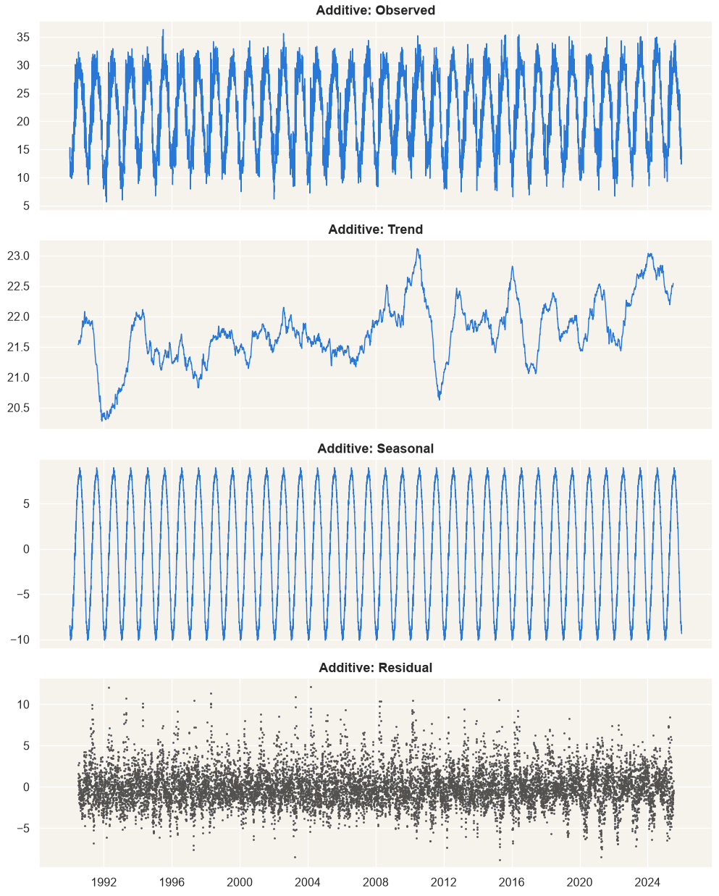
Understand the data before any model
TASK 4 RECAP · WHAT I LEARNT
The calendar explains most of it. A 19 °C swing, 2.2 °C of daily noise → season as sine/cosine inputs.
Fig. 9a · Additive decomposition
Weather remembers only days. The link fades in ~5 days → lags 1–3; no lag 365.
Beat a simple baseline first. “Tomorrow = today” scores 1.04 °C → every model scored on the same days.
Extremes are weather, not errors. Outliers match storms, heat and cold → keep them; judge models on them.
Check the data, not only the weather. Rain doubles at 2016; wind direction breaks in 2013.
Even EDA can leak the future. My normals used all 36 years → from now on, training years only.
BIGGEST LESSON
The EDA wrote the model: every Task 5 choice traces back to a Task 4 finding.
Cairo weather forecasting · Esraa
Source: NASA POWER, 1990–2025 · 07 / 31
Notes:
The most important thing Task 4 taught me is that the exploration is not a side step: it writes the model. The decomposition shows a huge fixed season, a slow trend and about 2.2 °C of daily noise, which is all a model really has to learn. Persistence became the bar, extremes stayed in the data, the 2016 rain change fixed the rain years, and the leakage I found in my own normals made every Task 5 normal and scaler use training years only.

Slide 8
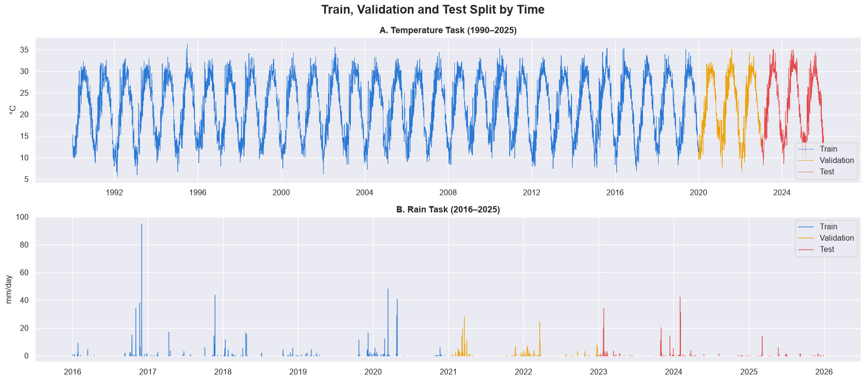
Six things that changed, and why
FROM TASK 4 TO TASK 5 · DIFFERENCES
1 · THE QUESTION
2 · THE TOOLS
Fig. 14 · Same split by time in both tasks
Describe 1990–2025 → forecast tomorrow from today
Baselines → SARIMAX with season, trend, memory; LSTM
Why: a forecast can be checked on the future
Why: turn the patterns found into one forecast
3 · NO LEAKAGE
4 · VALIDATION
Normals from all years → training years only
One split → walk-forward on 13 years; test once
Why: no future value may enter a forecast
Why: one number can be luck
SO WHAT
Data, target and split stay the same, so every Task 5 number is directly comparable with Task 4.
5 · STORM SIGNS
6 · EXTREMES
Each sign alone → signs combined
Counted → forecasts judged on them, warned ahead
Why: weak signs can be strong together
Why: the days that matter are where forecasts fail
Cairo weather forecasting · Esraa
Source: NASA POWER, 1990–2025 · 08 / 31
Notes:
The data did not change; the question did. Task 4 described, Task 5 predicts. To predict honestly, normals had to come from training years only, the validation had to repeat over many years, and the test years had to be touched once. The storm question moved from one sign at a time to signs together, and the extremes Task 4 only counted became the days on which Task 5 judges its forecasts. Because the split stays the same, every number can be compared directly.

Slide 9

How each question became sharper
FROM TASK 4 TO TASK 5 · SHARPER QUESTIONS
TASK 4 QUESTION
WHAT IT TAUGHT ME
SHARPER TASK 5 QUESTION
ANSWER
H2, H4 · More hot days? Fewer cold nights?
Count max > 40.1 °C days and min < 5.7 °C nights, as Task 4 did
17 → 31 hot days a year
Use one fixed definition
H5 · Do storms give a warning?
Q5 · Do the signs together warn of a storm tomorrow?
20.4 % chance, 30×
One sign at a time hides signals
H2 + H5 · Heat builds up over days
Ask about events frequent enough to learn
Q3 · Can we warn of a very hot day 1–3 days ahead?
77 % caught, 1 day ahead
H1 · Test years warmest: cold bias?
Days picked by outcome bias the verdict
Q4 · Too cold on hot days chosen in advance?
0.11 °C, not 0.88
All six · Patterns in the past
Q1, Q2 · How far ahead is it useful? When is it weakest?
About a week; spring
Describing is not forecasting
Goal 2 · Rain tomorrow?
Q6 · Can a model beat “rain today → rain tomorrow”?
No: F1 0.42 vs 0.47
Beat the bar on the same days
Cairo weather forecasting · Esraa
Source: NASA POWER, 1990–2025 · 09 / 31
Notes:
This is how I developed the questions. Each Task 4 question taught me something about asking: fix one definition, combine weak signs, ask about events frequent enough to learn from, choose the days you judge on in advance, and ask what can be known before it happens. Each lesson turned into a sharper question with a measurable answer. H6 could not be sharpened: Khamasin needs wind direction, which is missing after 2012, so I only ask what the daily data can show. The next three slides open the storm, heat and cold-bias questions.

Slide 10
Storm signs are weak alone, strong together
SHARPER QUESTIONS · H5 → Q5 STORM WARNING
Fig. 10 · Chance of a storm tomorrow, by the signs today (2016–2025)
20.4 %
Any day
0.7 %
storm chance after rain + falling pressure (usual 0.7 %)
Rainy season (Oct–Apr)
1.2 %
+ rain today
10.7 % · 15×
+ rain today + humid
7.8 %
12 of 25
+ rain today + pressure falling
20.4 % · 30×
storms start on a dry day, with no sign at all
+ rain + humid + pressure falling
14.3 %
Rainy season, dry today
0.6 %
SO WHAT
Dry + humid + pressure falling
0 of 134 days
Keep the simple rule. A model with 15 storms to learn from did no better (CSI 0.13 vs 0.11).
Task 4 (Fig. 12a) tested each sign alone: every link below 0.06
Cairo weather forecasting · Esraa
Source: NASA POWER, 1990–2025 · 10 / 31
Notes:
Task 4 asked whether storms have a signature and tested each sign alone; every correlation was below 0.06, so the answer was “almost no warning”. In Task 5 I asked the sharper question: what is the chance of a storm tomorrow for each combination of signs today? Rain today alone raises it 15 times; rain plus falling pressure raises it about 30 times, to one day in five, covering 10 of the 25 storms. Humidity adds nothing once it rains. A dry day gives no warning at all. A logistic model trained on only 15 storms was not better than this readable rule, so the rule is kept.

Slide 11
More very hot days, and we can warn of them
SHARPER QUESTIONS · H2 → Q3 HEAT WARNING
Fig. 11a · Very hot days a year (max > 40.1 °C)
Fig. 11b · Very hot test days caught, of 93
77 %
1 day ahead
31.0
72 · model
caught 1 day ahead (persistence 61 %); test F1 0.63 vs 0.61
57 · persistence
18.6
19.0
2 days ahead
≈ 2×
16.3
16.6
72 · model
42 · persistence
very hot days: 17.2 a year (1990–2019) → 31.0
3 days ahead
65 · model
SO WHAT
90s
00s
10s
20–22
23–25
36 · persistence
Heat builds up, so it can be seen coming. The price: more false alarms (63 vs 36).
Cairo weather forecasting · Esraa
Source: NASA POWER, 1990–2025 · 11 / 31
Notes:
Task 4 answered H2 with “partly”. With Task 4’s own fixed definition, max above 40.1 °C, Cairo had 16 to 19 very hot days a year in every period up to 2022, and 31 a year in 2023–2025. So the sharper question became useful: can we warn of such a day in advance? A logistic regression trained on 1990–2019, with its threshold picked on 2020–2022, catches 72 of 93 test days one day ahead against 57 for persistence, and still beats persistence two and three days ahead. It turns two Task 4 answers, more hot days and heat builds up, into a warning.

Slide 12
The “cold bias” was how I picked the days
SHARPER QUESTIONS · H1 → Q4 COLD BIAS
Fig. 12 · Bias on test days, real − forecast (°C; positive = too cold)
0.88 → 0.11
All test days (1,095)
+0.13
°C bias: hot days picked by outcome vs in advance
Picked by outcome: hottest 5 % (131)
+0.88
In advance: forecast says “hot” (101)
+0.11
0.992 °C
In advance: warm spell of 3+ days (323)
+0.12
In advance: warm spell of 5+ days (214)
+0.16
validation MAE with warm-spell inputs: no change
Same M2 forecasts, 2023–2025. Only the way the days are chosen changes.
SO WHAT
Judge on days chosen in advance. The real bias is +0.13 °C everywhere: warming ahead of the trend (H1).
Cairo weather forecasting · Esraa
Source: NASA POWER, 1990–2025 · 12 / 31
Notes:
Task 4 warned the test years are the warmest, so I checked for a cold bias. Steps 8 and 9 first suggested the model is almost 0.9 °C too cold on the hottest days and 2 °C too cold on the first day of heat waves. That was a trap: those days were chosen because they turned out hotter than expected, so any forecast looks too cold on them. Judged on hot days chosen in advance, the bias is only 0.11 to 0.16 °C, the same as on all days. Telling the model a warm spell is running changed nothing. I corrected my own earlier reading.

Slide 13


Twelve steps from clean data to a verdict
TASK 5 · THE PIPELINE
13,149
6
13
1
days from Task 4’s clean data
models vs 4 baselines
walk-forward test years
run on the test years
Fig. 13 · The Task 5 forecasting pipeline, with each step’s result
1 · Split
2 · Baselines
3 · ADF+KPSS
4 · Orders
5 · Diagnose
6 · Validate
13,149 days, by years
Bar: 1.04 °C
d = 0, + trend
K = 3, AR(3)
Ljung-Box passes
0.992 vs 1.072
7 · Walk-fwd
8 · Test once
9 · Storms
10 · LSTM
11 · Compare
12 · Sharper Qs
13 of 13 years
0.940 vs 1.038
Storm day 1.65 °C
0.929 °C
All within 0.06
Heat warning
RULES
Fitted on training years only · chosen on validation · test used once · same days as the baselines
Cairo weather forecasting · Esraa
Source: NASA POWER, 1990–2025 · 13 / 31
Notes:
This is the whole Task 5 pipeline on one slide, each step with its headline result. Steps 1 to 6 build and choose the model on the training and validation years; step 7 repeats the check year by year; step 8 is the single run on the test years; steps 9 to 12 test the Task 4 questions. The rules at the bottom are what make the numbers honest.

Slide 14
Split by time, never at random
STEPS 1–2 · PREPROCESSING AND TIME SPLIT
Fig. 14 · Train, validation and test split by time: A temperature, B rain
30 / 3 / 3
years of train / validation / test: 10,957 / 1,096 / 1,095 days
18 days
sudden temperature days caught by a 31-day rolling z-score (fixed threshold: 0); all kept
SO WHAT
A random split lets the model see the future. Whole years test every season; the test years are the hottest.
Cairo weather forecasting · Esraa
Source: NASA POWER, 1990–2025 · 14 / 31
Notes:
Step 1 loads the clean Task 4 data and sets a daily frequency; it adds no new gaps. No missing values in the used columns, no impossible values. The rolling 31-day z-score finds sudden warm days that a fixed threshold misses, because no single temperature is extreme for the whole year; they are kept, because these are exactly the days the project wants to forecast. Rain starts in 2016 because the rain data changed that year, and rain tomorrow is only 3.9 to 6 % of days, so it is judged by hits and F1, never accuracy.

Slide 15
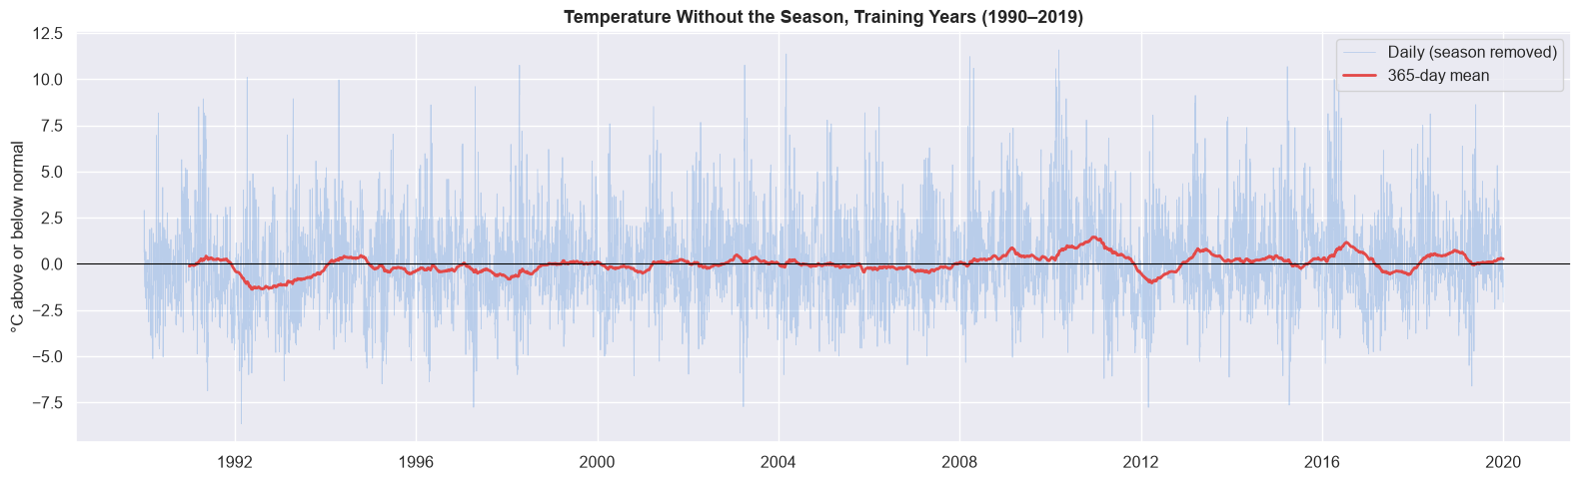
Stationary around a trend: no differencing
STEP 3 · STATIONARITY · ADF + KPSS
Fig. 15 · Temperature without the season, training years 1990–2019
d = 0, D = 0
plus a linear trend term in the model
0.76 → 0.09
lag-1 ACF after one difference: possible, not needed
SO WHAT
A difference would make every warm day permanent; Task 4 showed temperature returns to normal.
< 0.001
≤ 0.01
≥ 0.10
ADF p: no unit root in all 3 series
KPSS (c) p once the season is removed
KPSS (ct) p: fine around a trend
Cairo weather forecasting · Esraa
Source: NASA POWER, 1990–2025 · 15 / 31
Notes:
Three tests on the training years only. ADF rejects a unit root for the raw, the season-free and the differenced series. KPSS with a constant accepts the raw series but rejects the season-free one, and KPSS with a trend accepts all three. That pattern means stationary around a trend: once the 19 °C yearly wave is removed, the slow warming becomes visible, which is what the red line in the figure shows. So no differencing, the season as inputs, and a trend term.

Slide 16
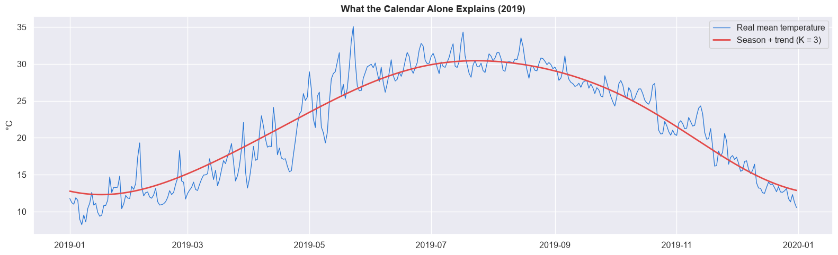
Three waves carry the whole year
STEP 4A · THE SEASON AS SINE AND COSINE
Fig. 16 · What the calendar alone explains (2019): real vs season + trend, K = 3
+0.27 °C
per 10 years, the learned trend: between H1’s days (+0.23) and nights (+0.41)
6 numbers
replace a 365-day seasonal SARIMA, too heavy for 10,957 days
SO WHAT
88.2 %
K = 3
2.3 °C
Task 4’s “the season rules” became inputs. ARIMA only learns the day-to-day weather.
explained by one sine/cosine pair
chosen; a 4th pair gains 0.002 °C
left over for ARIMA to learn
Cairo weather forecasting · Esraa
Source: NASA POWER, 1990–2025 · 16 / 31
Notes:
A seasonal ARIMA would need a season of 365 days, far too heavy to fit on almost 11,000 days. Instead the year goes in as sine and cosine waves. One pair already explains 88 % of the daily temperature; three pairs are enough, and a fourth only follows noise. In the figure, the red line is the calendar plus the trend for 2019: it follows the year closely, and what is left are the day-to-day swings, biggest in spring. The learned trend, +0.27 °C per decade, matches Task 4’s H1.

Slide 17
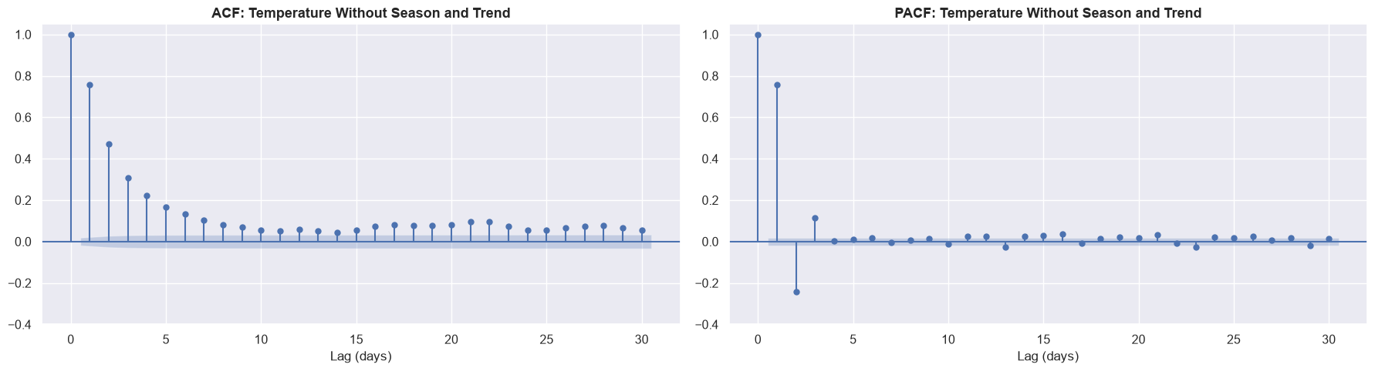
Today depends on the last three days
STEP 4B · ACF AND PACF · CHOOSING THE ORDERS
Fig. 17 · ACF and PACF of temperature without season and trend
AR(3)
manual ARIMA(3,0,0) = M2, written down before auto_arima ran
(3,0,3)
auto_arima = M3: AIC −31, but BIC only −9, with 3 more parameters
SO WHAT
0.76
−0.24
0.11
The extra MA terms add little. Both models go forward; validation decides.
PACF lag 1 (Task 4: 0.77)
PACF lag 2
PACF lag 3, then about 0
Cairo weather forecasting · Esraa
Source: NASA POWER, 1990–2025 · 17 / 31
Notes:
With season and trend removed, the ACF falls slowly while the PACF has three clear bars and then stops. That is the textbook sign of an AR(3) process: today depends directly on the last three days, and the lag-1 value matches Task 4. I wrote this choice down before running auto_arima, so the comparison is honest. auto_arima added three moving-average terms that catch the weeks-long warm and cold spells; the AIC likes them, the BIC barely does.

Slide 18
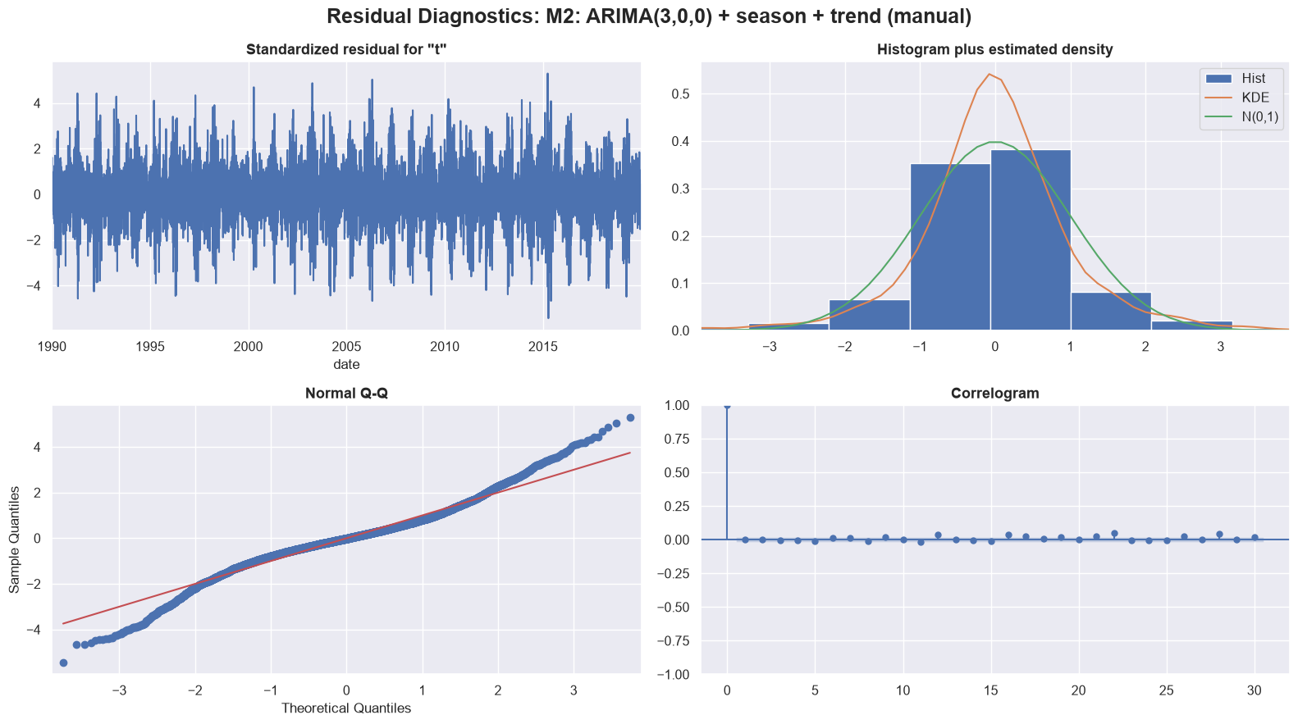
No memory left, but spring has heavy tails
STEP 5 · FIT FOUR MODELS · RESIDUAL CHECKS
Fig. 18 · Residual diagnostics of M2: residuals, histogram, Q-Q, correlogram
p = 0.26
−1,300
Ljung-Box lag 7, M2: passes
AIC when the season is added
5.6
3×
kurtosis: big misses are common
spread in April (2.3 °C) vs August
SO WHAT
The 5 biggest misses are all March–April: Task 4’s storms and desert-wind days. Step 9 tests them directly.
Cairo weather forecasting · Esraa
Source: NASA POWER, 1990–2025 · 18 / 31
Notes:
Four models are fitted on 1990–2019: M1 without the season, M2 the manual choice, M3 auto_arima’s, and M4 which adds yesterday’s humidity and pressure. Adding the season lowers the AIC by about 1,300, and M2 and M4 pass Ljung-Box at lag 7; M1 fails, and M3 fails only because six terms leave one degree of freedom. The plots show residuals centred on zero with a flat correlogram, but heavy tails: big misses happen more often than a normal curve expects, and they cluster in spring. Yesterday’s pressure helps in training, humidity does not.

Slide 19
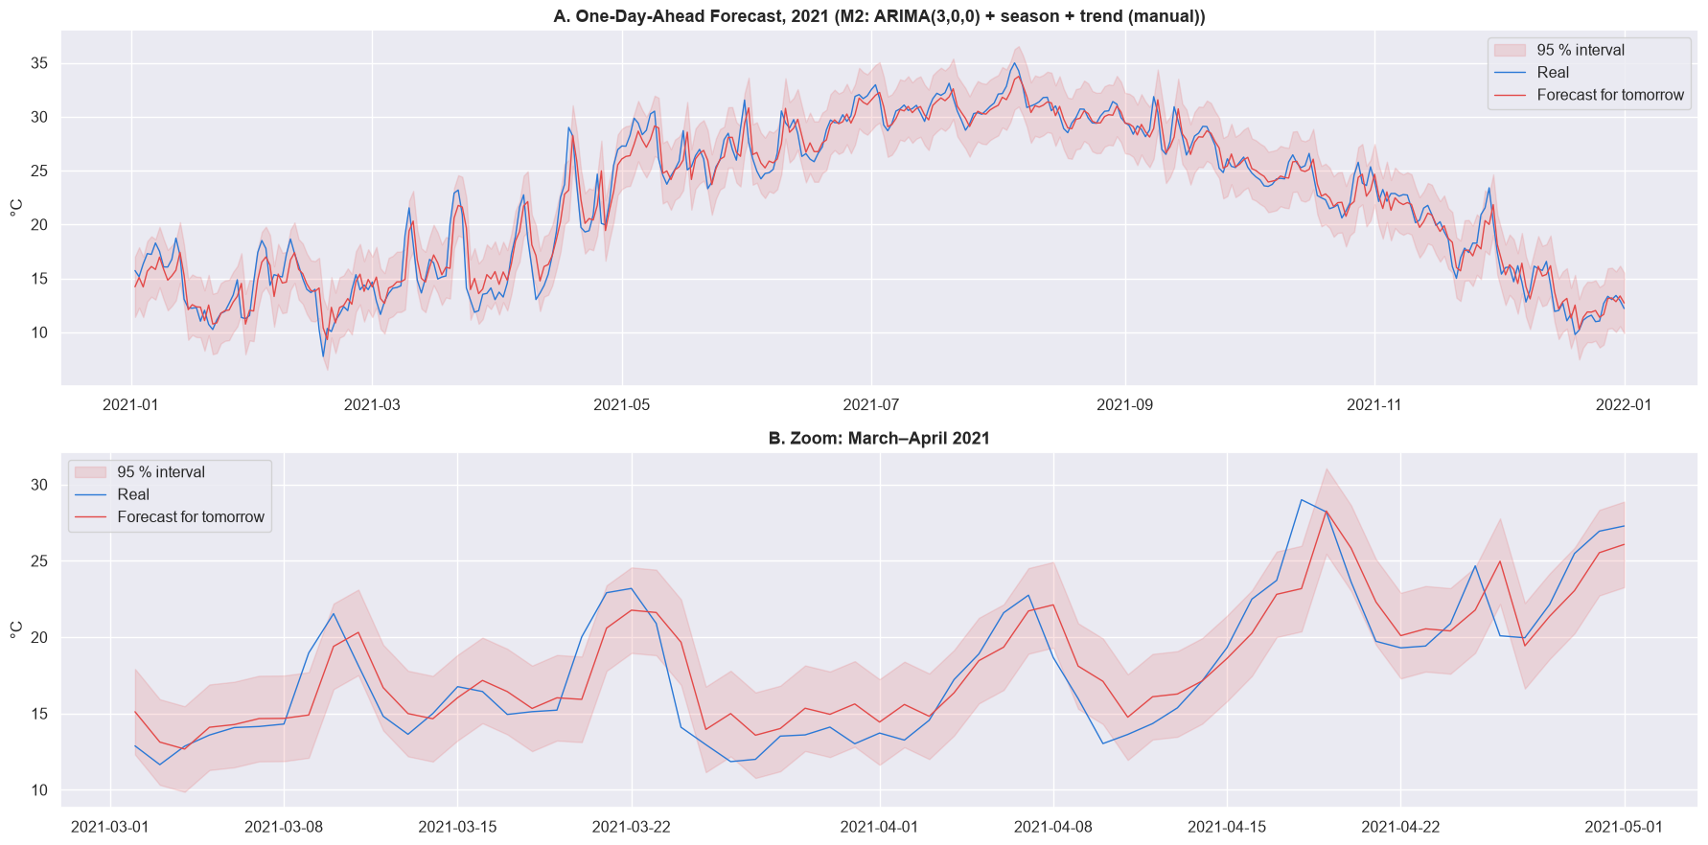
Every seasonal model beats every baseline
STEP 6A · FORECASTING TOMORROW ON VALIDATION
Fig. 19 · M2 one-day-ahead forecast with 95 % interval: A 2021, B March–April zoom
0.992 °C
M2 MAE on 2020–2022 vs 1.072 for “tomorrow = today”
−7.5 %
error vs persistence; M3 0.990, M4 0.994, no-season M1 1.032
SO WHAT
Rule set before the scores: simplest wins unless 0.01 °C better → M2. Its weakness: one day late on jumps.
Cairo weather forecasting · Esraa
Source: NASA POWER, 1990–2025 · 19 / 31
Notes:
Each model keeps what it learned on 1990–2019 and forecasts tomorrow for every day of 2020–2022, using only the days up to today. The gain over persistence is small but real: the model knows a day warmer than normal tends to move back toward normal, and persistence does not. The three seasonal models are only 0.004 °C apart, so the rule I wrote before seeing the scores picks the simplest one, M2. The March–April zoom shows the main weakness: the first day of a sudden jump is missed, then caught.

Slide 20
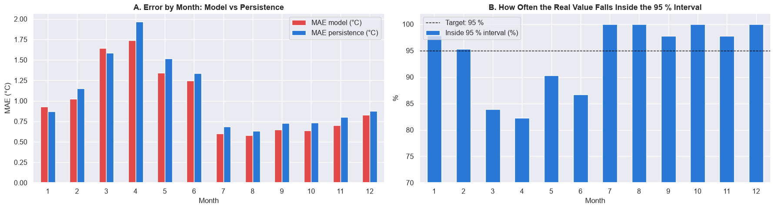
Spring is still the hardest season
STEP 6B · ERROR AND INTERVAL BY MONTH
Fig. 20 · A error by month, model vs persistence · B real value inside the 95 % interval
94.3 %
10 of 12
SO WHAT
Right on average, wrong by season: 82–87 % in spring, 100 % in summer.
inside the 95 % interval overall; bias −0.06 °C
months beat persistence; Mar–Jun errors 1.25–1.74 °C
Cairo weather forecasting · Esraa
Source: NASA POWER, 1990–2025 · 20 / 31
Notes:
One number hides the seasons, so the errors are split by month. Spring is the hardest, exactly as Task 4 said: errors of 1.25 to 1.74 °C from March to June against about 0.6 °C from July to October. The 95 % interval is right on average, 94.3 %, but it has the same 5.6 °C width all year while April misses are about three times August’s, so it is too narrow in spring and too wide in summer. There is no cold bias on the validation years.

Slide 21
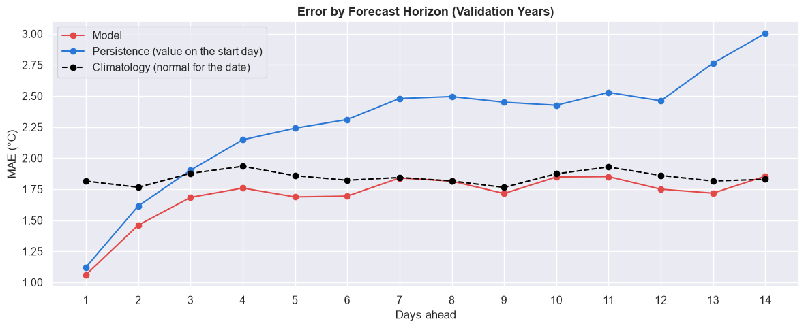
Useful for about a week, then it’s the calendar
STEP 6C · ERROR BY FORECAST HORIZON
Fig. 21 · MAE 1 to 14 days ahead: model vs persistence vs climatology
≈ 6 days
beats climatology (day 4: 1.76 vs 1.93 °C); equal from day 7
5.6 → 8.9 °C
95 % interval width, day 1 → day 7, then flat
SO WHAT
Memory lasts days, so a storm warning many days ahead from daily data is not realistic.
Cairo weather forecasting · Esraa
Source: NASA POWER, 1990–2025 · 21 / 31
Notes:
Forecasting further ahead answers sharper question Q1: how far ahead is the forecast useful? The model beats persistence at every horizon and beats the calendar normal up to about six days ahead. From day 7 the model and climatology are equal, because the weather’s memory lasts only a few days; after that the best guess is the date, and the model knows it. Persistence does not, so it keeps getting worse. This sets the limit for any warning built on daily data.

Slide 22
Better than persistence in every year
STEP 7 · WALK-FORWARD VALIDATION
Fig. 22 · M2 vs persistence, 13 test years, each refit on all earlier years
13 of 13
years M2 beats persistence (2010–2022)
8.8 %
mean gain: 4.5 % (2018) to 13.2 % (2014)
SO WHAT
The gain is not luck. M2 is confirmed: as good as M3 and M4, and simpler.
0.991 °C
1.072 °C
0.07 °C
M2 mean MAE, folds 2020–22
persistence, same folds
M2 range across years (persistence 0.13)
Cairo weather forecasting · Esraa
Source: NASA POWER, 1990–2025 · 22 / 31
Notes:
One validation period gives one number, and one number can be luck. So the check is repeated one year at a time: refit on every year before, forecast the next year, as the model would really be used. On three folds the models stay within 0.003 °C of each other and beat persistence every year. Run on 13 years, M2 beats persistence in all 13, by 8.8 % on average. Calm years leave less to gain; hard years like 2021 are hard for every method. The test years are still untouched.

Slide 23
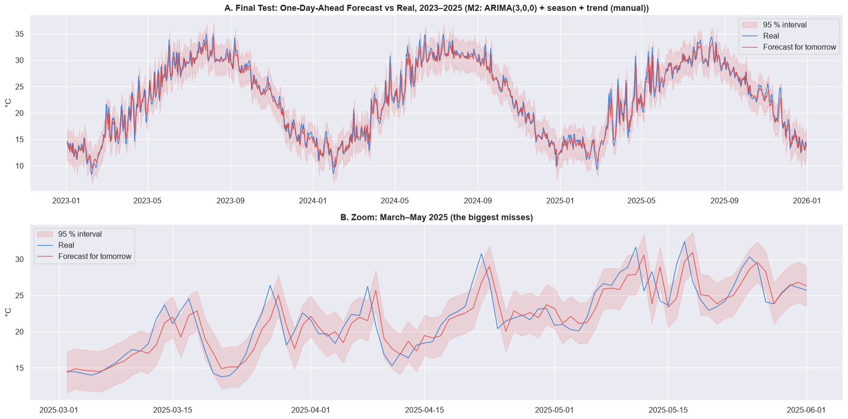
0.94 °C on years the model never saw
STEP 8 · THE KEY RESULT · FINAL TEST, RUN ONCE
Fig. 23 · M2 forecast vs real, 2023–2025, with 95 % interval; B zoom March–May 2025
0.940 °C
MAE vs 1.038 for persistence: 9.5 % lower
3 of 3
test years won: 0.955 · 0.886 · 0.977 °C
95.1 %
inside the 95 % interval; only 82–85 % in Mar–May
Answer: about 10 % better than “tomorrow = today”, in every test year.
Cairo weather forecasting · Esraa
Source: NASA POWER, 1990–2025 · 23 / 31
Notes:
This is the single run on the test years, fixed in advance: M2, refit on 1990–2022. It forecasts tomorrow’s mean temperature with a typical error of 0.94 °C, 9.5 % below persistence, and wins in each of 2023, 2024 and 2025, matching the 8.8 % from the walk-forward. The interval holds overall but is too narrow in spring, where the biggest misses are, for example 12 May 2025. There is a small overall cold bias of 0.13 °C in every year: the warming of 2023–2025 running ahead of the learned trend, as Task 4 warned.

Slide 24
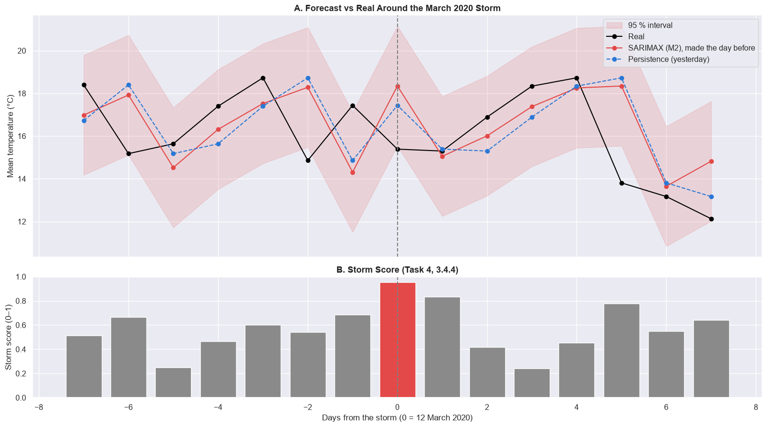
One day of surprise, then a quick recovery
STEP 9 · THE STORM STORY (H5)
Fig. 24 · Forecast vs real around the March 2020 storm, with Task 4’s storm score
2.95 °C
1.65 °C
miss on 12 Mar 2020; 0.25 the next day
storm-day error (persistence 1.30)
1.00 °C
0.93 °C
the day before: no warning sign
every other day (persistence 1.04)
SO WHAT
Models win on ordinary days and lose on the days that matter. Task 4’s “no warning” holds for temperature.
Cairo weather forecasting · Esraa
Source: NASA POWER, 1990–2025 · 24 / 31
Notes:
Step 9 measures the chosen model on exactly Task 4’s events. On ordinary days it beats persistence, 0.93 against 1.04 °C. On the 13 storm days of 2020–2025 its error jumps to 1.65 °C and persistence is better; the day before and the day after are back to normal. The March 2020 storm, Task 4’s lowest pressure in 36 years, shows it day by day: the model saw the warm-up of 11 March and expected it to continue, missed the storm day by 2.95 °C, and was right again the next day. Heat-wave first days are worse still, 2.06 °C, which the cold-bias slide explains.

Slide 25
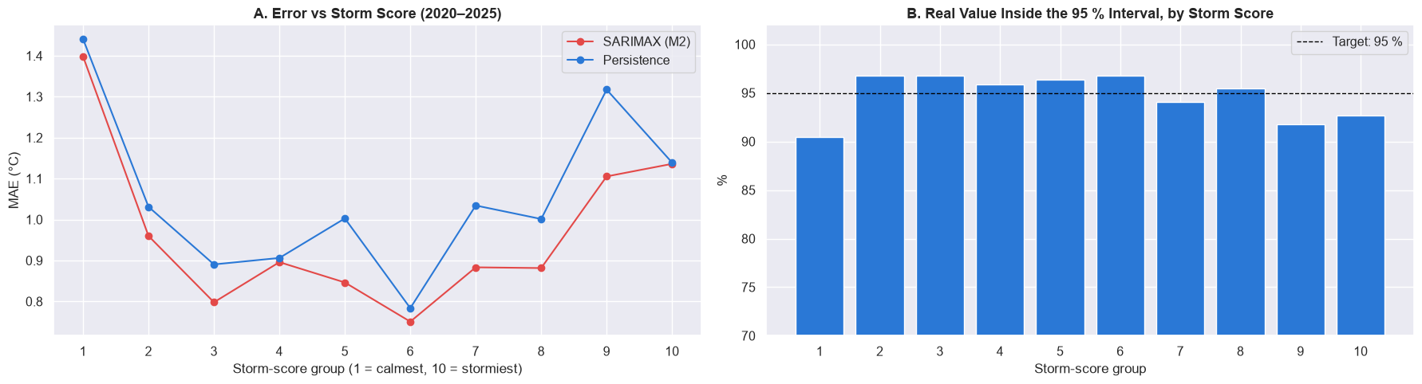
Both calm and stormy extremes are hard
STEP 9 · ERROR VS TASK 4’S STORM SCORE (H5, H6)
Fig. 25 · A error by storm-score group, 2020–2025 (1 = calmest, 10 = stormiest) · B inside the 95 % interval
1.40 °C
13 of 25
SO WHAT
Both ends are sudden jumps. The calm, hot, dry end looks like Khamasin (H6).
calmest 10 % of days; middle groups 0.75–0.90
storms came after a rain day: “rain today” warns of half
Cairo weather forecasting · Esraa
Source: NASA POWER, 1990–2025 · 25 / 31
Notes:
Using Task 4’s storm score as a label of how unusual each day was, the error is U-shaped: lowest in the middle, higher for the stormiest days and highest for the calmest ones. A low storm score means rising pressure, a jump in max temperature and dry air: the sudden warm, dry pattern of heat waves. It looks like Task 4’s Khamasin days, but that definition needs a south wind, and wind direction is missing after 2012, so H6 cannot be tested here. On the rain side, 13 of the 25 storms came after a rain day, so “rain today” is the only warning daily data gives for about half of them.

Slide 26
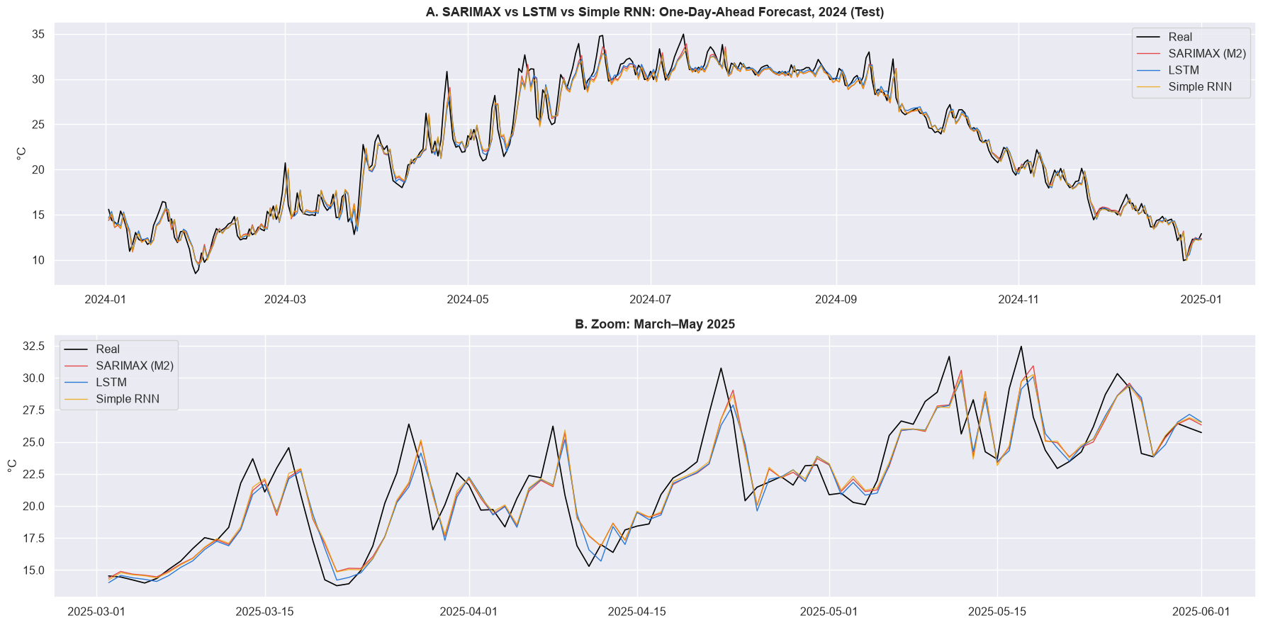
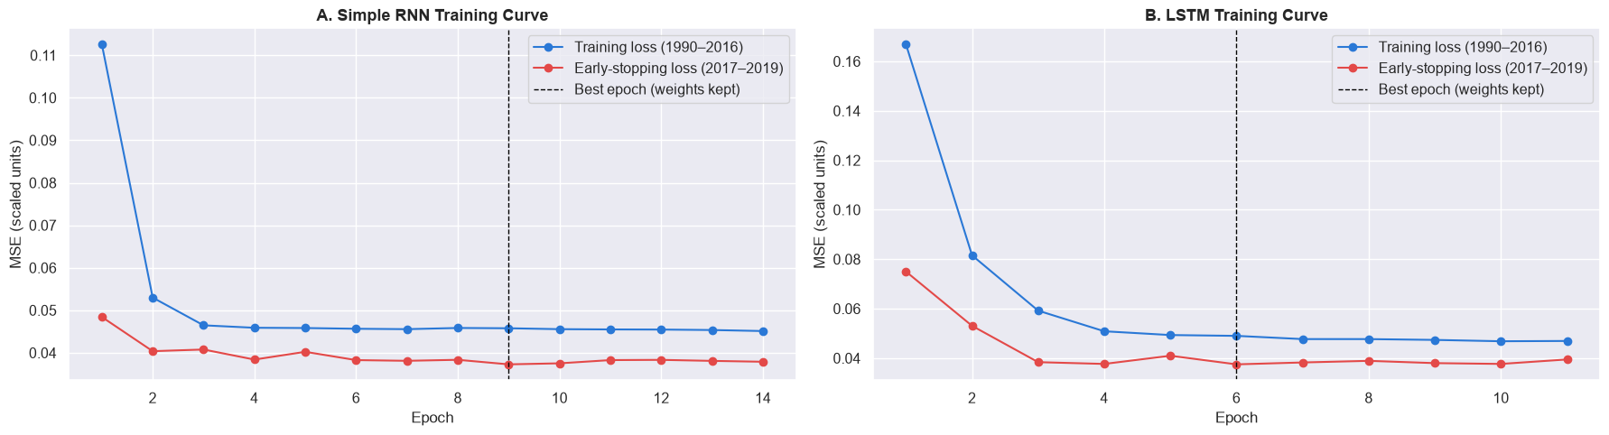
Deep learning confirms SARIMAX
STEP 10 · BONUS · SIMPLE RNN AND LSTM
Fig. 26a · SARIMAX vs LSTM vs Simple RNN on the test years: A 2024, B March–May 2025
Fig. 26b · Training curves, early stopping
0.929 °C
LSTM on test; RNN 0.934, M2 0.940
SO WHAT
Only 0.011 °C apart. M2 stays: same accuracy, a reliable interval, every part explained.
Cairo weather forecasting · Esraa
Source: NASA POWER, 1990–2025 · 26 / 31
Notes:
The bonus networks get a fair shot: the last 30 days plus the day of year, a scaler fitted on training years only, early stopping on 2017–2019, then a refit on 1990–2022 for the test. Both stop learning within a few epochs. On test the LSTM is lowest, 0.929 °C, but only 0.011 °C below M2, and its forecasts differ from M2 by just 0.21 °C a day: they learned the same thing, recent days plus a pull back toward normal. With one daily series and a three-day memory there is little left for a network to find, so M2 stays the chosen model.

Slide 27
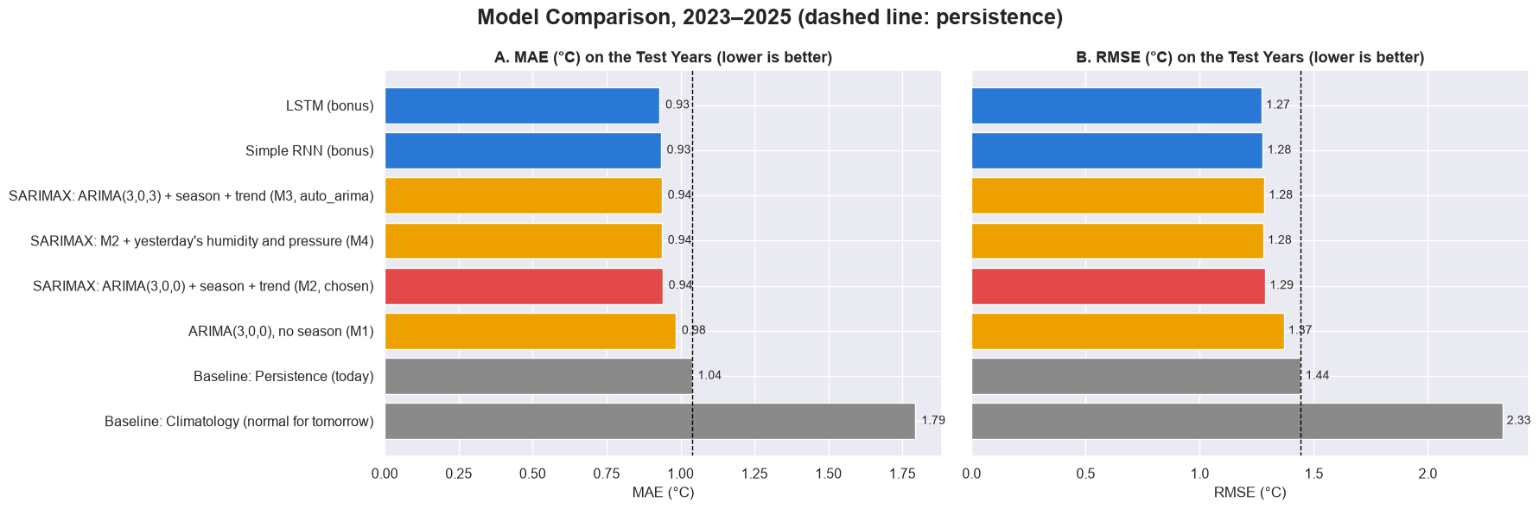
Six models, all within 0.06 °C
STEP 11 · MODEL COMPARISON, TEST 2023–2025
Fig. 27 · MAE and RMSE on the test years (lower is better; dashed line: persistence; red: chosen M2)
−9.5 %
1.54 °C
SO WHAT
The season matters most; the model type barely does.
M2 vs persistence; LSTM −10.5 %, no season −5.2 %
persistence wins the 35 event days (M2 1.90)
Cairo weather forecasting · Esraa
Source: NASA POWER, 1990–2025 · 27 / 31
Notes:
Every model and baseline on the same 1,095 test days. Every model beats every baseline; the six models sit within 0.06 °C, and the only clear gap is the model without the season, M1. So knowing where “normal” is matters far more than which model learns the last few days. On the 35 Task 4 event days the order flips and persistence is best, but those days are picked by what happened, which favours forecasts that lean less toward normal, as the cold-bias slide showed.

Slide 28
Six questions, answered twice
TASK 4 VS TASK 5 · THE SIX QUESTIONS
H1
Confirmed
H2
Strengthened
H3
Used
Task 4: nights +0.41, days +0.23 °C a decade
Task 4: partly; 2023–24 the most extreme
Task 4: most likely a data change
Task 5: trend learned, yet 0.13 °C too cold on 2023–25
Task 5: 17.2 → 31.0 very hot days a year; warnable ahead
Task 5: rain and storms use 2016–2025 only
H4
Confirmed
H5
Refined
H6
Not testable
Task 4: yes, slowly; 2022 still cold
Task 4: partly; storms give no warning
Task 4: yes; hot, dry, south wind
Task 5: cold nights 18.1 → 21.0 → 9.7 a year
Task 5: rain + falling pressure → 20.4 %; dry days: none
Task 5: no wind direction after 2012; similar pattern
SO WHAT
Where both tasks agree, the answer is stronger; where they differ, Task 5 shows which part holds.
Cairo weather forecasting · Esraa
Source: NASA POWER, 1990–2025 · 28 / 31
Notes:
Each Task 4 question, answered twice. H1: the warming is real and still running ahead of the learned trend, since forecasts for 2023–2025 are 0.13 °C too cold in every year; nights versus days is not tested because the target is the daily mean. H2 is stronger: with Task 4’s own definition, very hot days almost doubled. H3 is used as a decision, not re-tested. H4: rarer, with cold years still possible. H5 is refined: storms after rain give a one-day warning, storms after a dry day give none. H6 cannot be tested after 2012.

Slide 29
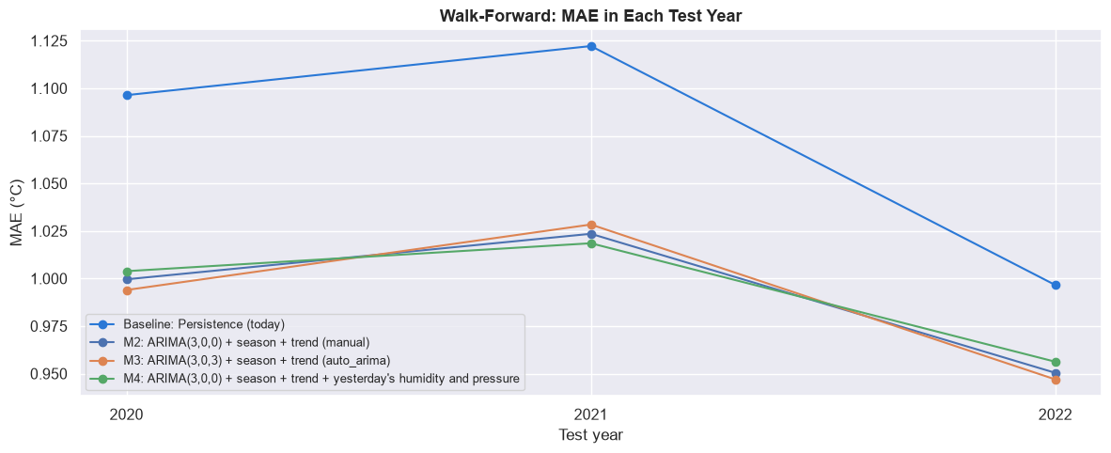
Measured on the future, not described
WHY TASK 5 IS MORE ACCURATE
Fig. 29 · Walk-forward MAE per test year: every model below persistence
2023–25
0
judged on years never seen, used once
future values in any normal, scaler or model
13 of 13
95.1 %
walk-forward years won: not one lucky number
every answer gets an error in °C and an interval
0.11 °C
30×
SO WHAT
real bias on days chosen in advance (not 0.88)
storm risk once signs are combined, not alone
Task 4 described the target; Task 5 measures it on unseen years, in °C, on fair days. An answer that holds there is evidence, not a pattern.
Cairo weather forecasting · Esraa
Source: NASA POWER, 1990–2025 · 29 / 31
Notes:
Why Task 5 represents the target more accurately than Task 4. First, it is judged on the future: the test years were used once. Second, no future value leaks into any normal, scaler or model, which Task 4’s EDA normals did. Third, the result is repeated over 13 years, so it is not one lucky number. Fourth, every answer becomes an error in degrees with an interval, by month and by event. Fifth, the verdicts are fair: days are chosen in advance, which turned a 0.88 °C “bias” into 0.11. Sixth, signs are combined, which turned “no warning” into a 30-fold storm risk after rain and falling pressure.

Slide 30
Six lessons from forecasting tomorrow
TASK 5 · WHAT I LEARNT
0.011 °C
Rule first
1.65 vs 0.93
Simple and explainable can win
Decide before seeing the scores
Averages hide the days that matter
M2, 12 parameters, vs the LSTM
the 0.01 °C rule kept the test honest
°C error, storm day vs ordinary day
0.88 vs 0.11
15 storms
~1 week
How you pick days is the verdict
Rare events can’t train a model
Know the forecast’s limits
°C bias: by outcome vs in advance
keep a rule; warn about heat instead
useful range; spring interval too narrow
BIGGEST LESSON
A sharp question beats a complex model: asking it in advance, on fair days, changed more answers than the LSTM did.
Cairo weather forecasting · Esraa
Source: NASA POWER, 1990–2025 · 30 / 31
Notes:
What Task 5 taught me. A simple model I can explain was as good as a neural network. Writing the decision rule before seeing the scores kept the test honest. A good average hides the days that matter: storms and heat waves are where every model fails. How I choose the days I judge on decides the verdict, as the cold-bias trap showed. Rare events cannot train a model, so for storms a readable rule beats a fitted one, and heat, which is frequent, is where a warning works. And a forecast has limits: about a week, and a spring interval that is too narrow.

Slide 31
The calendar and yesterday, proven on the future
CONCLUSION
WHAT THE TWO TASKS SHOW
Temperature: M2 forecasts tomorrow with 0.94 °C error, 9.5 % below “tomorrow = today”.
LIMITS AND NEXT STEPS
Interval: too narrow in spring → a width that changes with the season.
Heat: very hot days nearly doubled; 77 % can be warned of a day ahead.
Sudden jumps: missed on day one → hourly pressure or satellite data.
Storms: rain + falling pressure gives a 1-in-5 warning; dry-day storms give none.
Rain: “rain today” stays the best forecast (F1 0.47).
Warnings: check the heat warning and storm rule on more years.
Models: the LSTM confirms SARIMAX; the season matters most.
Thank you. Questions?
Cairo weather forecasting · Esraa
Source: NASA POWER, 1990–2025 · 31 / 31
Notes:
Task 4 ended with “the calendar and yesterday carry most of the signal”. Task 5 turned that into a model and proved it on years it never saw: 0.94 °C, about 10 % better than repeating today, in every test year. It also turned two Task 4 answers into warnings, for very hot days and for storms that start after rain, and was honest about where forecasts fail: sudden jumps, spring, and storms that start on a dry day. Next steps are a season-dependent interval, finer data for sudden changes, and checking the warnings on more years.

